Slide 1
Learning Graph Database – Neo4j

Slide 2
Goal
Questions

Slide 3
Outline
Objectives and Intents
Graph Database
Modeling
Cypher Query Language
GraphGist

Slide 4
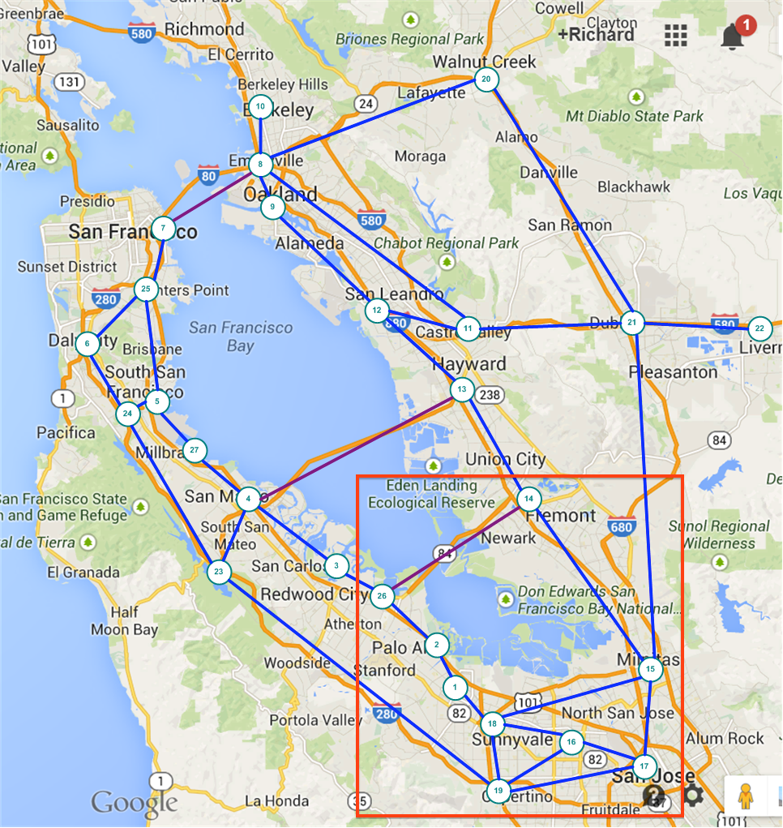
Using San Francisco Road Map to Understand Some Concepts in Social Networking and Graph Database

Slide 5
Cypher

Slide 6
Objects in Domain
Cities
name, population
population growth, incoming workers, out coming workers
has major facilities (school, airport, sport stadium,..)
Roads connect Cities
name, distance (length)

Slide 7
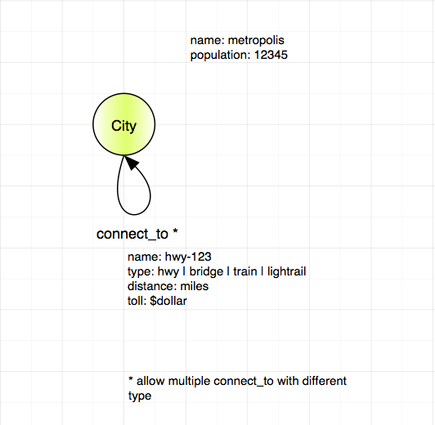
Model – version 0.1 - Simple

Slide 8
Cypher Statement - 1
Add cities.
Add connect_to as relationship between cities.
Verify cities are connected with paths.
Inspect the properties.
Learning the uses of: CREATE, MATCH, RETURN, MERGE, web console.

Slide 9
Model – version 0.2 – more Objects

Slide 10
Add more objects:
Schools, Airport, Stadium.
Connect them with relationships:
has.
Use the database to answer some questions.

Slide 11
Model – version 0.3

Slide 12
Model – version 0.1

Slide 14
GraphGist

Slide 15
Backup and Reference Slides

Slide 16
Not Only SQL (NOSql)
Insert 4 types

Slide 17
Graph Database

Slide 18
Neo4j

Slide 19
References

